Slide 1
Problem Solving scale
The interpretation and use of the test score is
It’s concurrently strongly related to Spatial Reasoning proficiency
It’s concurrently moderately related to Creative proficiency
That item scores on the Problem-solving scale can be regressed over a single factor

Slide 2
What I did
CFA
Evaluating the fit measures
Factor correlations
Estimating the reliability for the PS-Factor
Factor loadings
Correlations
Sum score correlations
Item correlations

Slide 3
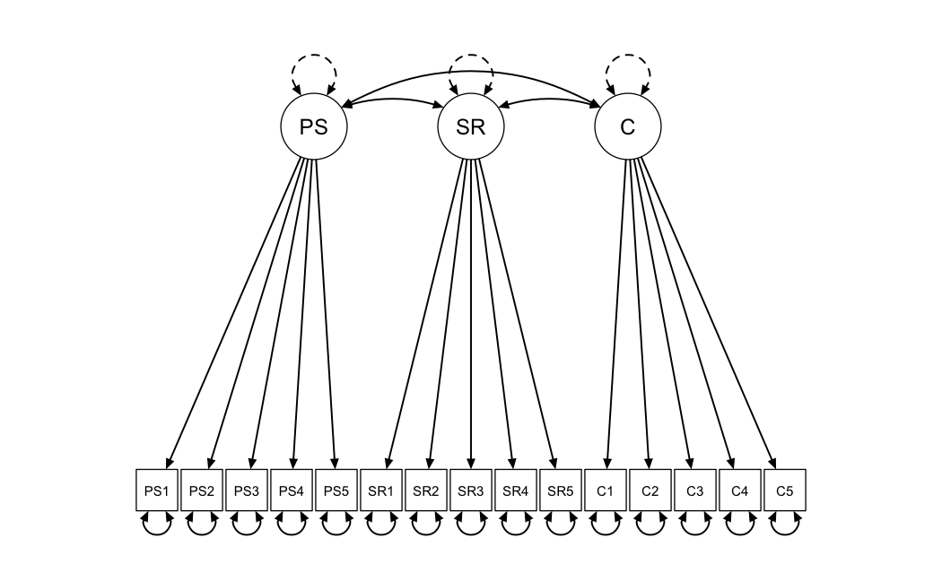
CFA

Slide 4
Evaluating the Fit measures
RMSEA | CFI | SRMR
0.034 | 0.981 | 0.066
The fit measures above are indicating a good fit for the model.
This supports their claim that the latent variables are related.

Slide 5
Factor correlation
Correlation between factors in model
They also claim a criterion based sort of claim, that the relation should hold a certain standard – moderate between creativity and Strong for Spatial reasoning
 | PS | SR | C
PS | 1.000
SR | 0.754 | 1.000
C | 0.475 | 0.374 | 1.000
This is also supporting their concurrent claim, that factor score informs on scores on other factors – linearly at least

Slide 6
Coefficient Omega
⍵ (with hat) = 0.79
Means that the precision of the Score is quite low
If it’s meant to capture individuals Problem Solving proficiency than it’s not precise enough, I compared to the Criterion scales
This is a good estimate of the reliability if the factor model is a good fit, otherwise it might mean that this isn’t the true reliability of the scale
PS3 (item 3)
The best item λ = 0.923 , ᴪ = 0.148 (std)
The other items had higher variances
So that led me to check…

Slide 7
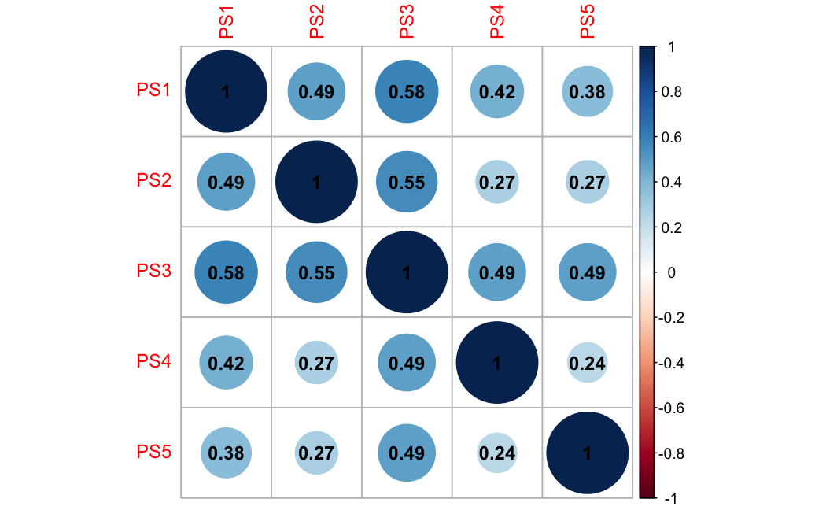
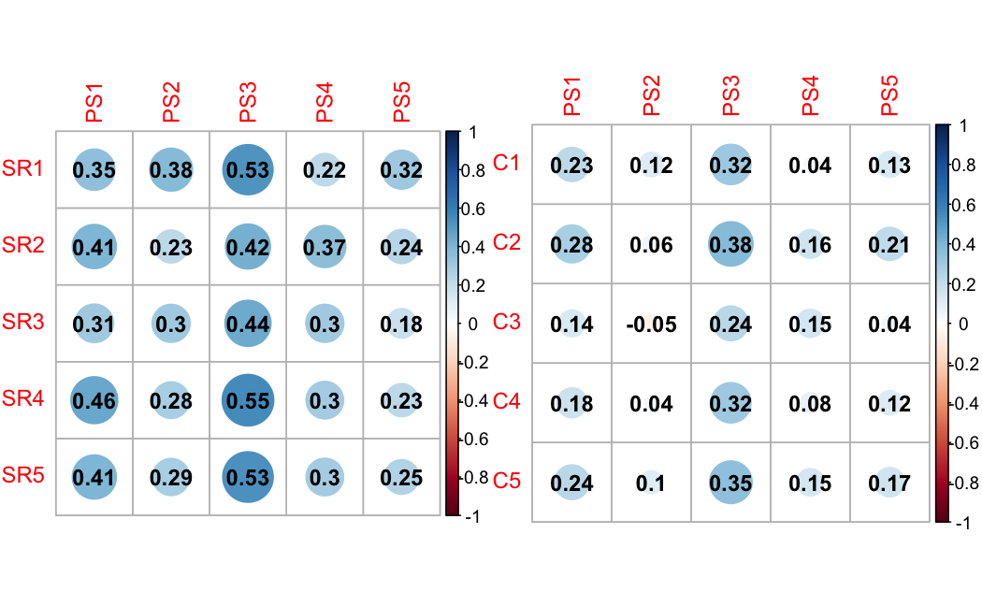
Correlations
Item 3 is moderately correlated to all other items
Together with the ᴪ^2-estimates of the model, it seems as if the items are capturing something not assigned the factor
Item 1 is also moderately correlated to the other items
This in turn that the estimated reliability coefficient omega for the scale, (=0.79), supports the claim that a single factor might not be a good fit for this construct
We also see that the PS2, PS4, PS5 are not correlated to eachother.

Slide 8
High correlation of individual items
We also see that individual items correlate highly with items on the other scales, indicating that the construct is not well-defined.

Slide 9
Summary
CFA
In support of the concurrent evidence to support the interpretation and use of scale
Low reliability – not very precise in measuring Problem Solving
Correlation
Evidence against the scale
It seems as if the items are capturing something else than the factor
Discriminatory evidence isn’t supporting the interpretation of the scale as measuring PS, as it seems that the most influential item (PS3) might also be measuring traits meant to be captured by the SR scale. So this is evidence against the interpretation and use of the scale as capturing PS ability.

